Slide 1
Higher Education for Students with Intellectual Disabilities: University of Maryland, College Park

Slide 2
Notes:
Promo Video Link: TerpsEXCEED Promotional Video

Slide 3
What is TerpsEXCEED?
TerpsEXCEED is a 2-year certificate program at the University of Maryland College Park
For students with intellectual disabilities (ID) who would not be able to apply and attend UMCP through a traditional pathway
A non-degree program that culminates in a UMD certificate
Includes a transcript of all students’ academic coursework (audit and P/F allowed)
Aligned with students’ career interests
Students participate in career development activities, work experiences,internships and paid jobs.
Notes:
Discussion

Slide 4
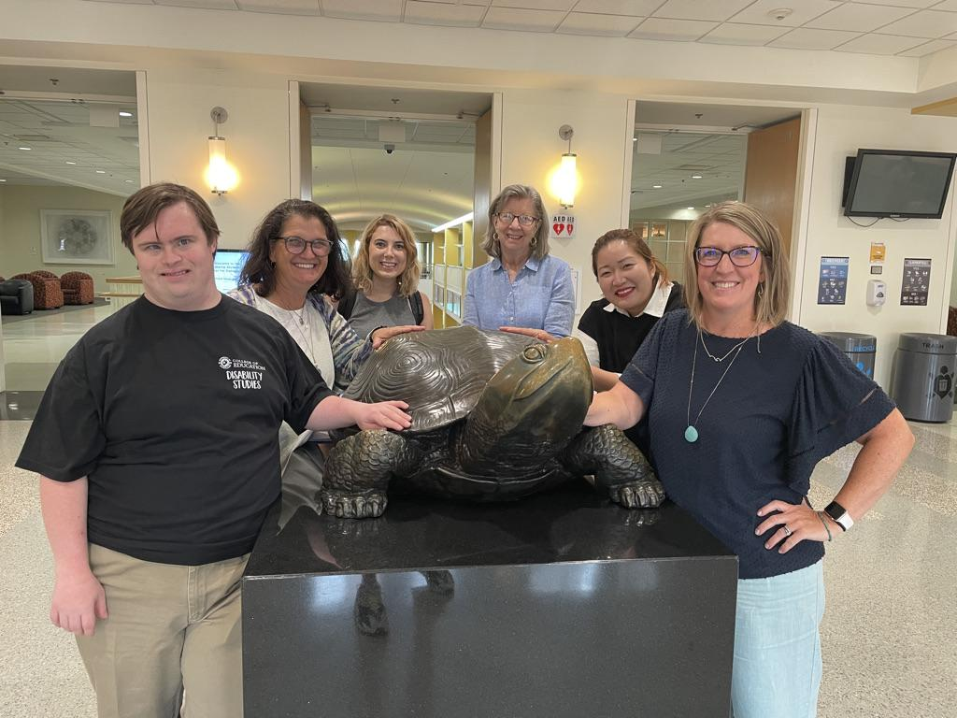
Who we are
Notes:
Discussion

Slide 5
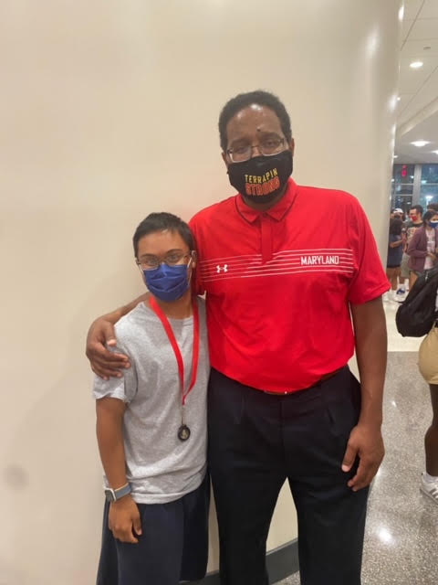
History of TerpsEXCEED
Gap of service in Maryland
Need in the state: families reached out
Capitalized on the momentum of Diversity, Equity & Inclusion movement to include DISABILITY
Financial support
Campus buy-in from highest level
Persistence!
Notes:
Discussion

Slide 6
Who is TerpsEXCEED for?
The student who will benefit the most from TerpsEXCEED:
Age: 18-26 at start of program
Willing to and capable of attending and completing UMD academic coursework
(at audit level at least)
Has work experience
Has experience with or shows ability for independent living
Can manage time and activities without one-on-one support
(this program does not offer 24/7 assistance)
Has access to and knows how to use a cell phone to communicate
Wants to attend a large university (UMCP has roughly 40,000 students) and exhibits appropriate behavior for a college campus setting
(all students will be held to the UMD Student Code of Conduct: https://policies.umd.edu/assets/section-v/V-100B.pdf)
Enjoys engaging in social activities and has interest in joining student organizations
Meets additional eligibility criteria (see top of Application)
Notes:
Defining and Documenting Intellectual Disability for TPSID and CTP Participation
The Higher Education Opportunity Act, in Section § 668.231, defines a student with an intellectual disability.
The term "student with an intellectual disability" means a student—
(A) with a cognitive impairment, characterized by significant limitations in—
(i) intellectual and cognitive functioning; and
(ii) adaptive behavior as expressed in conceptual, social, and practical adaptive skills; and
(B) who is currently, or was formerly, eligible for a free appropriate public education under the Individuals
with Disabilities Education Act [20 U.S.C. 1400 et seq.].
See page 2 of this document for more information on the definition of intellectual disability.
Documentation of Intellectual Disability from the HEOA Regulations (Higher Education Opportunity Act (Public Law 110-315) (HEOA)
The institution must obtain a record from a local educational agency that the student is or was eligible for
special education and related services under the IDEA. If that record does not identify the student as
having an intellectual disability, as described in paragraph (1) of the definition of a student with an
intellectual disability in § 668.231, the institution must also obtain documentation establishing that the
student has an intellectual disability, such as—
(1) A documented comprehensive and individualized psycho-educational evaluation and diagnosis of an
intellectual disability by a psychologist or other qualified professional; or
(2) A record of the disability from a local or State educational agency, or government agency, such as the
Social Security Administration or a vocational rehabilitation agency, that identifies the intellectual disability.
(Approved by the Office of Management and Budget under control number 1845–NEW4) (Authority:
20 U.S.C. 1091)
The TPSID FAQ page on the US Department of Education website provides the following
clarification re: students with autism in TPSID or CTP programs
(https://www2.ed.gov/programs/tpsid/faq.html)
7. Does the definition of intellectual disability (ID) include individuals with autism spectrum disorder?
The comprehensive transition and postsecondary program is targeted at providing access to postsecondary
education to those students with intellectual disabilities who traditionally have been unable to participate in
higher education. If a student with autism spectrum disorder (ASD) also has a co-occurring documented
intellectual disability (significant cognitive impairment with significant limitation in cognitive functioning, and
limitations in adaptive behavior, and who was formerly or currently eligible for IDEA services), that
student DOES meet the definition of an eligible student under the TPSID program.
If a student with ASD does not have a co-occurring documented intellectual disability that does not present
any significant intellectual or cognitive functioning or adaptive behavior, that student does NOT meet the
definition of an eligible student under the TPSID program. The student may be admitted to the institution, and
may be considered a student with a disability, and thus is entitled to disability support services and/or
accommodations consistent with other federal policies such as Section 504 of the Rehabilitation Act or the
Americans with Disabilities Act. In other words, in order for a student to receive supports and services via the
TPSID program, that student must still meet the TPSID program’s definition of a student with an intellectual
disability even if the student has ASD with significant cognitive impairment and significant limitation in
cognitive functioning or adaptive behavior.
The definition of intellectual disability included in the Higher Education Opportunity is based on this definition
from AAIDD.
What is ID and how is ID diagnosed?
American Association on Intellectual and Developmental Disabilities (AAIDD)
Excerpted from https://www.aaidd.org/intellectual-disability/definition/faqs-on-intellectual-disability
May 2021
ID is a developmental disability. Each person with ID will have their own strengths and weaknesses and will require
lifelong supports of a personalized level, intensity, and duration to optimally engage in their environment.
Clinical judgment plays an important role in all aspects of the determination of ID. As described in more detail in the
Manual, a clinician will consider evidence concerning each of the three diagnostic criteria, including any potential
sources assessment or measurement error:
Significant limitations in intellectual functioning
Significant limitations in adaptive behavior
Onset of both of the above limitations during the developmental period, which means that significant limitations
in both intellectual functioning and adaptive behavior in the individual have manifested before the age of 22.
As described in more detail in the Manual, all test results must be interpreted within the context of their administration
and any potential sources of testing error. In making a determination of ID, evidence in addition to test scores will
inform the diagnostician's clinical judgment of the person's overall functioning.
For more information on the diagnosis of ID, consult the AAIDD manual. The "Twenty Questions" document also
contains useful information concerning diagnosis, classification, and clinical judgement.
Resources
Twenty Questions and Answers Regarding the 12th Edition of the AAIDD Manual
Intellectual Disability: Definition, Diagnosis, Classification, and Systems of Supports (12th ed.)
Compiled from the Higher Education Opportunity Act, OMB

Slide 7
TerpsEXCEED Focus Areas
Career Exploration/Development
STUDENT
College Success/
Course Access
Trained Peer Mentors/
Campus inclusion
Notes:
Amy

Slide 8
TerpsEXCEED Components
2-year certificate program
Enrolled through the Office of Extended Studies
Each Semester:
Audit typical UMD Undergraduate Studies courses (6 credits)
Internship course (3 credits) & College Success/Independent Study (3 credits)
Will register for ADS
WBLEs, internships, jobs each semester
Access to all UMD clubs and activities – UMD student ID
On-campus housing/dining available
Peer mentoring program
Access to typical orientation, all facilities, all sports lotteries (like all students)
Will apply for CTP status and financial aid
Notes:
Discussion
Tuition and room and board at typical rate for that school year
Additional 3750/semester for support
Piloting Voc Rehab pay portion of tuition
Students who have Self-Directed Waiver who hire additional supports for evening/dorm/tutoring- whatever they designate for extra support needs

Slide 9
Career Exploration and Development
TerpsEXCEED partners with the University Career Center’s EmployABILITY Program to prepare students for the workplace.
3-credit class on career development
Skill building
Career exploration, informational interviews
Internships, on campus and off campus
Notes:
Nancy

Slide 10
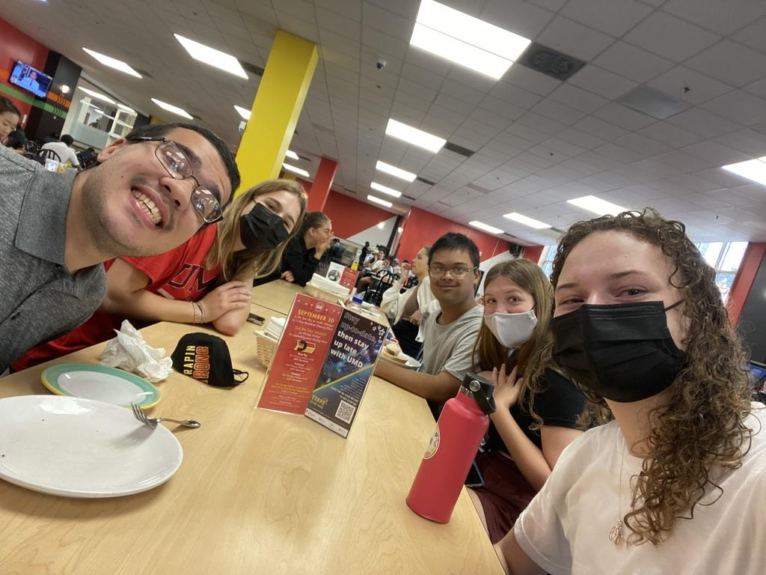
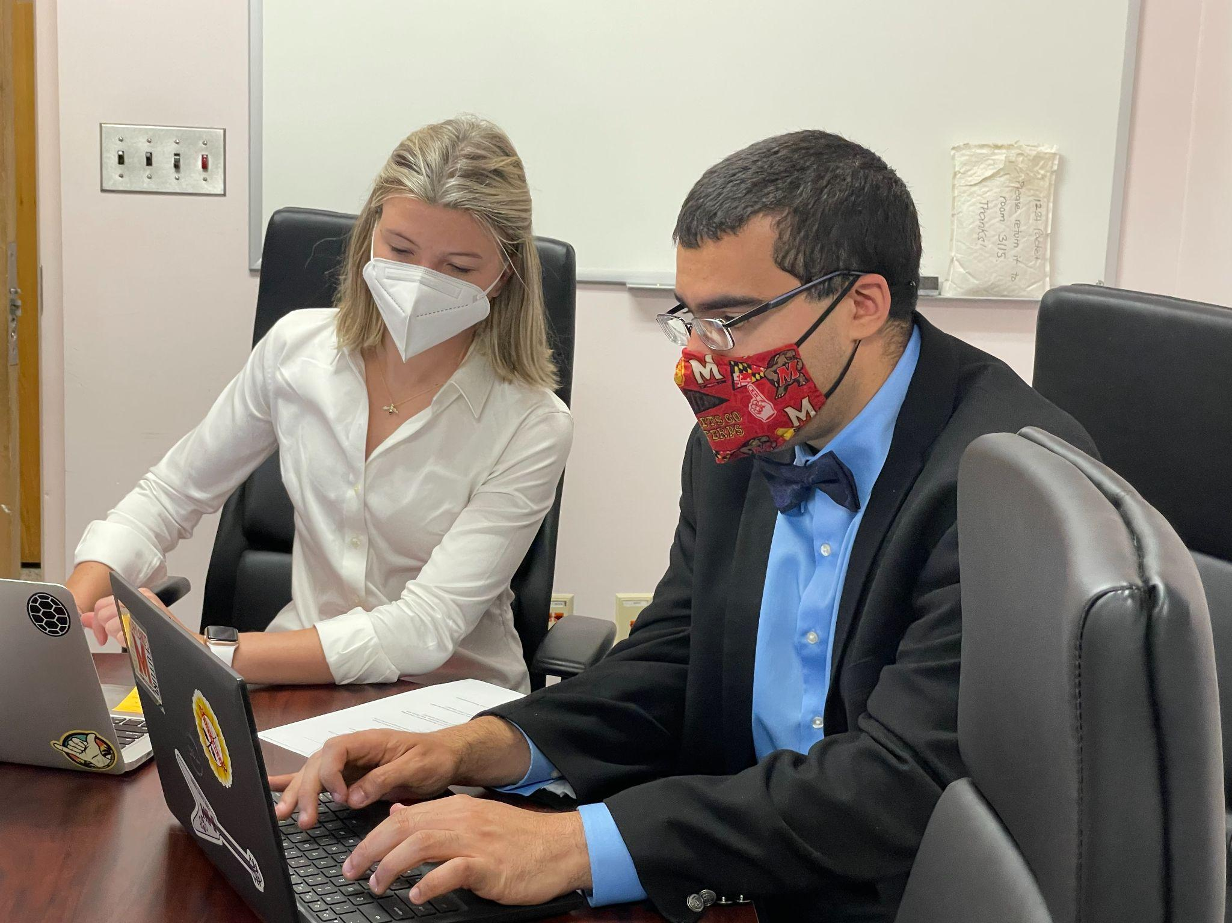
Peer Mentors
Learning New Practices
CRLA-Aligned Topics
Planning & Reflection
On-going Support
Lesson Plans & Weekly Logs
Weekly Check-ins
Notes:
Peer Mentors
CRLA (College Reading and Learning Association)
Intl Peer Educator Training Program Certification Level 1 & 2

Slide 11
Academic, Social and Career Supports
Individualized Goal Setting and Tracking
Trained RAs
Informed Professors
Peer Mentor coordination and collaboration to provide supports
Assignments, tests, classroom
On-the-job
Social/Communication
We do not provide 24/7 support

Slide 12
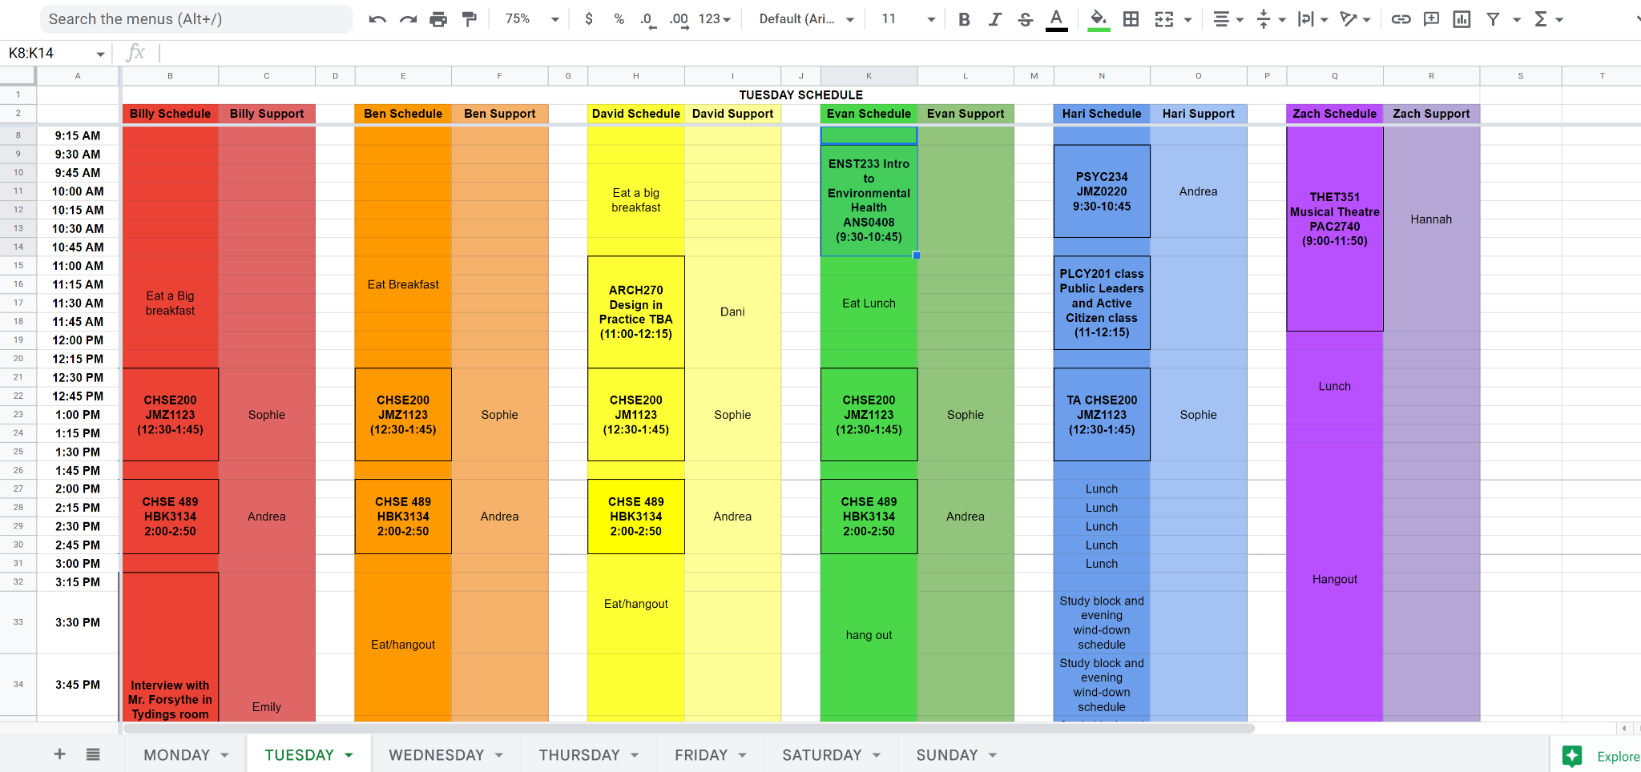

Slide 13
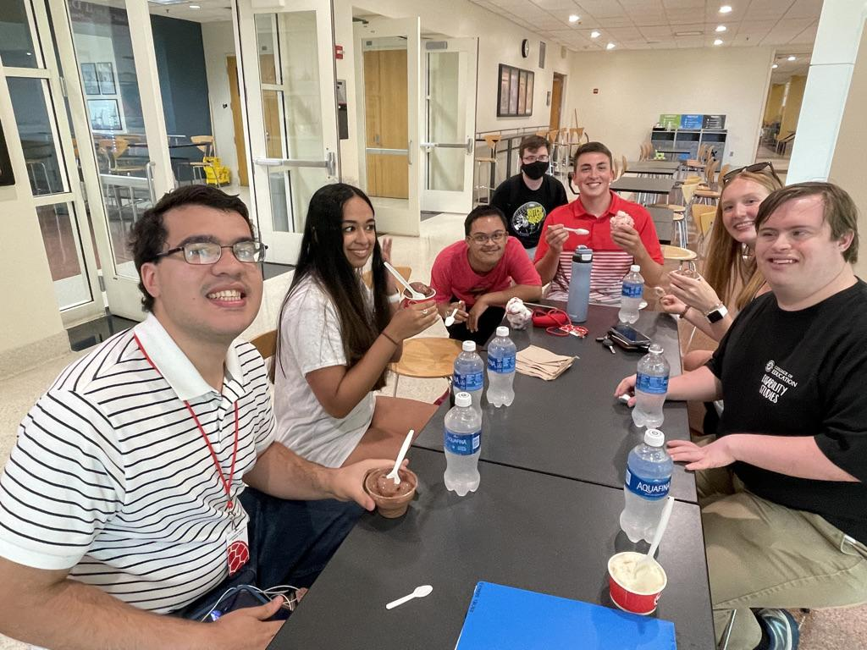
Peer Advocacy
Share personal experience & perspective with self advocacy
Contribute to peer mentor class
Identify weekly activities
Support TerpsExceed students with Portfolio
Support career class
Notes:
Adrian
Hi, my name is Adrian
My Role:
I am a Peer Advocate here at the TerpsExceed Program at the University of Maryland, where I support students in having a college experience like everybody else.
I also: attend the Peer Mentor class and speak on specifics about social engagement for example about my experience with self-talk and task analysis.
George Mason
I participated in a program similar to TerpsEXCEED at George Mason University. I had a successful experience in the post-secondary program at George Mason University because it helped me to 1) develop skills for employment; 2) increase my independence and decision-making; and 3), most importantly, increase my self-advocacy skills. I believe self advocacy is the most important skill for success as an independent adult.
Just like with the TerpsEXCEED students, As part of my George Mason Experience I had an internship. My internship: I was able to get a congressional internship in Rep Steny Hoyer’s office and this helped me to learn more about how laws are made and how to influence policy for people with disabilities and to advocate for them. That experience helped me to get a job with the national down Syndrome Society where I worked for 5 years before coming to the TerpsEXCEED program.
Supporting TerpsEXCEED Students
This extends from finding activities to aiding them in achieving their academic goals. For example:
Peer Mentor class support and personal perspective on self advocacy
Researching activities and helping them find clubs they want to participate in,
Support developing videos for student portfolios
Career class support help with the career class.
I really believe in post-secondary education because it helped me to be successful. I am very happy to be working here to make this dream come true for others.

Slide 14
TerpsEXCEED Admissions
Application Timeline:
Opening in December; closes February 1; Decisions by April 1
Student and Family Interviews for those found eligible
Housing submissions must be in by May 1
Application materials on our website: https://www.ihehub-umd.org/terps-exceed
Fees:
Typical UMD tuition, Room/Board and Fees apply: https://financialaid.umd.edu/resources-policies/cost-attendance
Program Fee for extra programmatic supports $3,750 per semester
Our goal is to secure the status of Comprehensive Transition Program for students with ID in order to offer financial aid
Students with current VR cases with Maryland DORS may be eligible for tuition assistance at the Maryland Community College rate
Notes:
Discussion

Slide 15
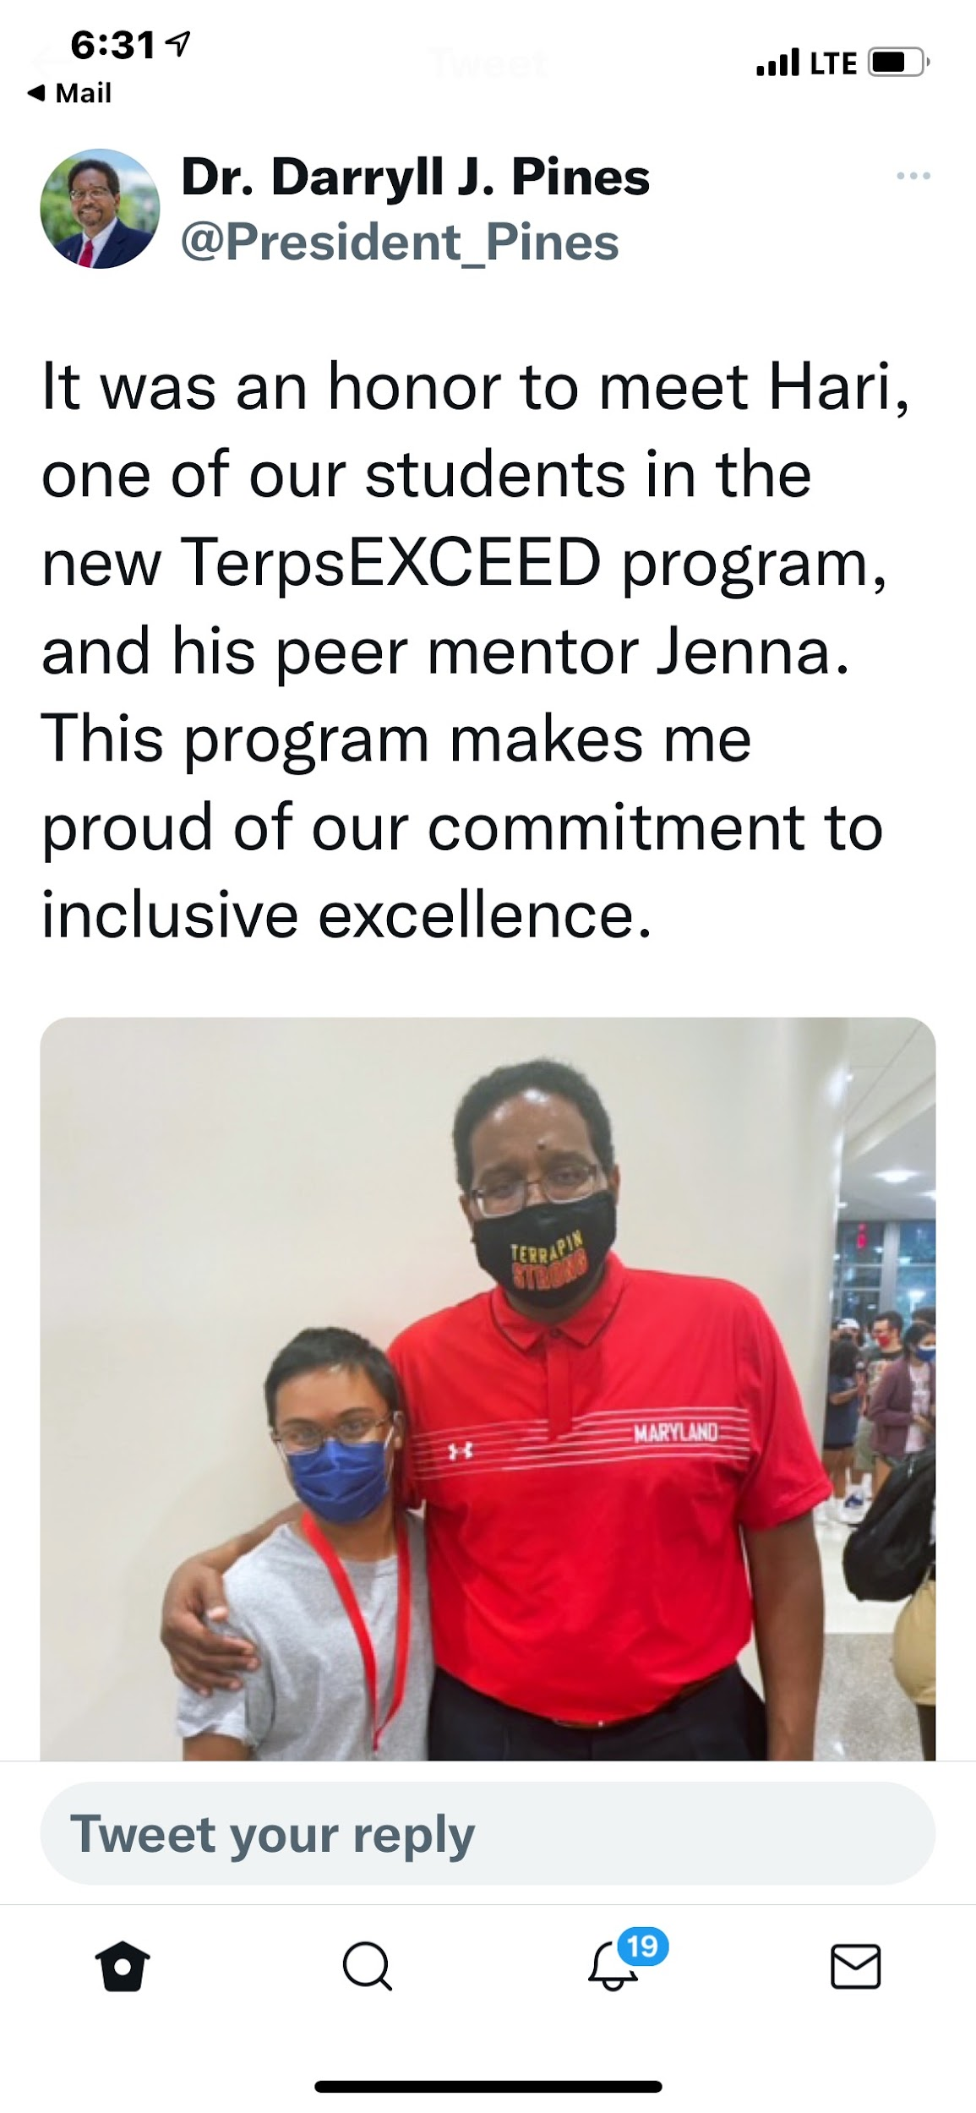
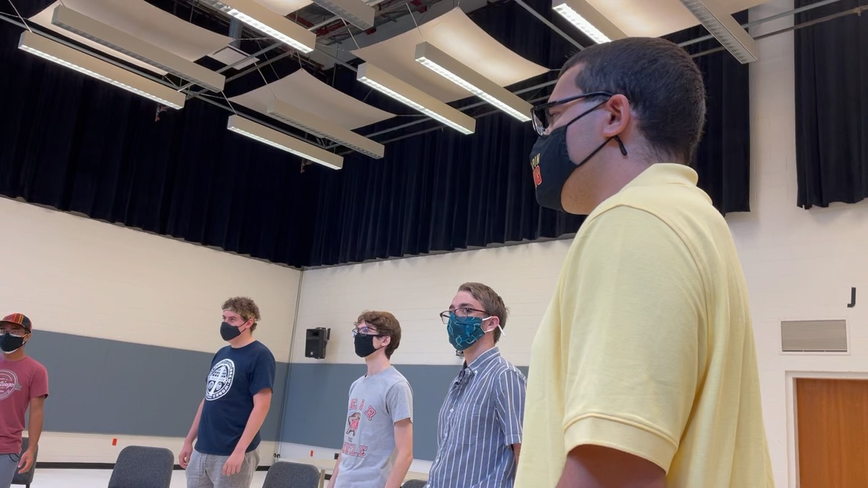
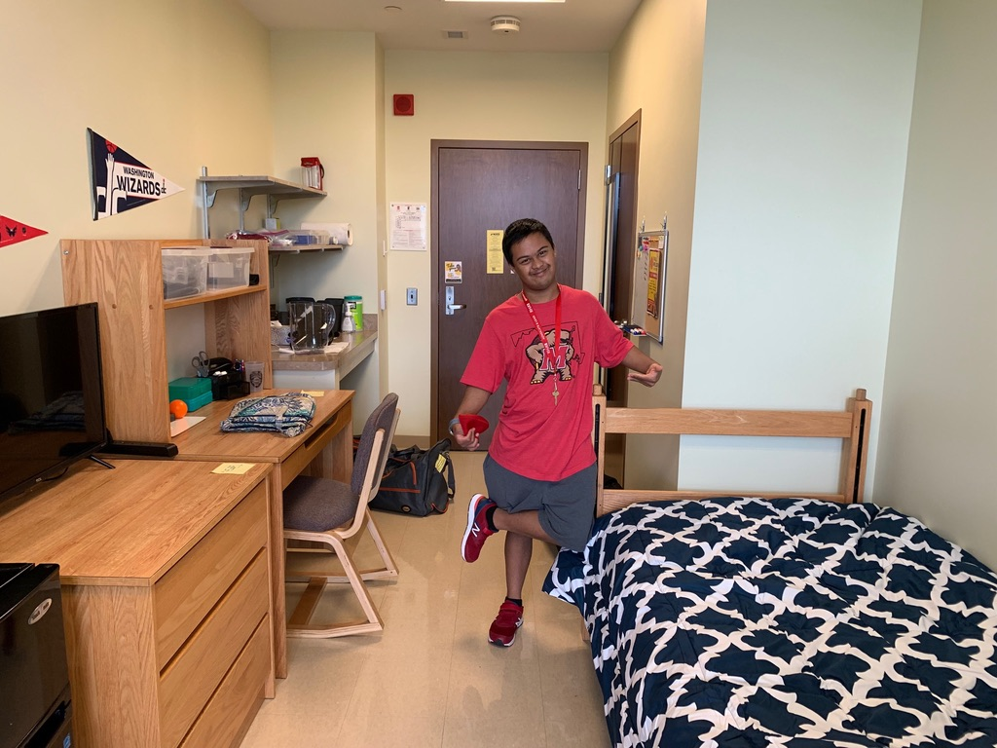
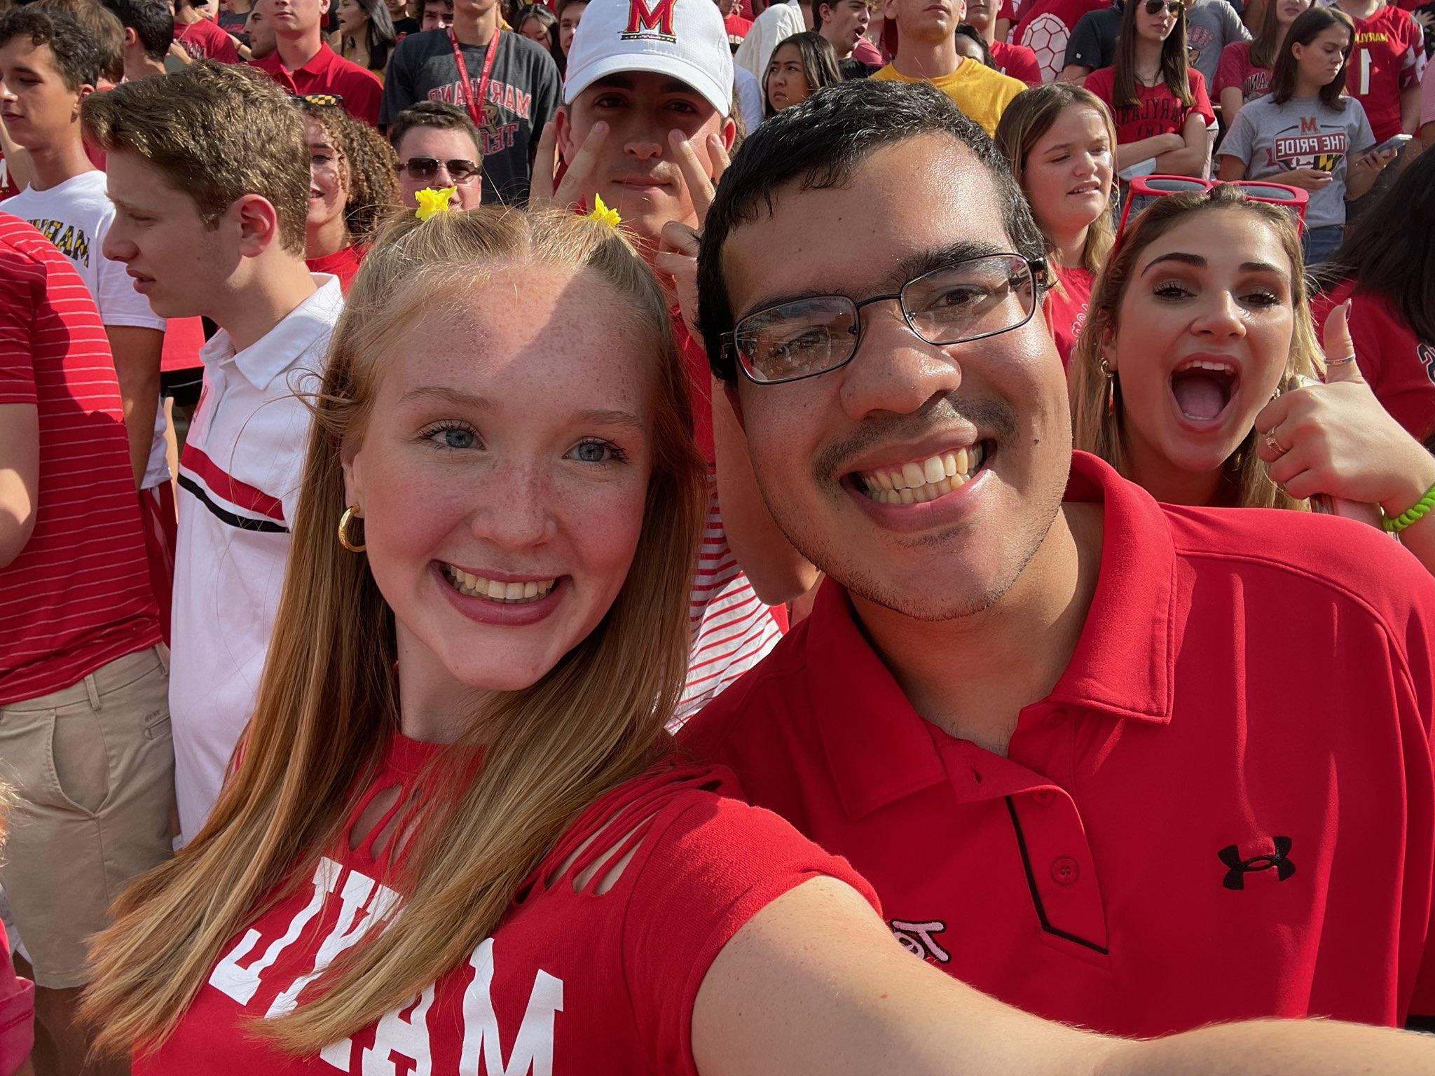
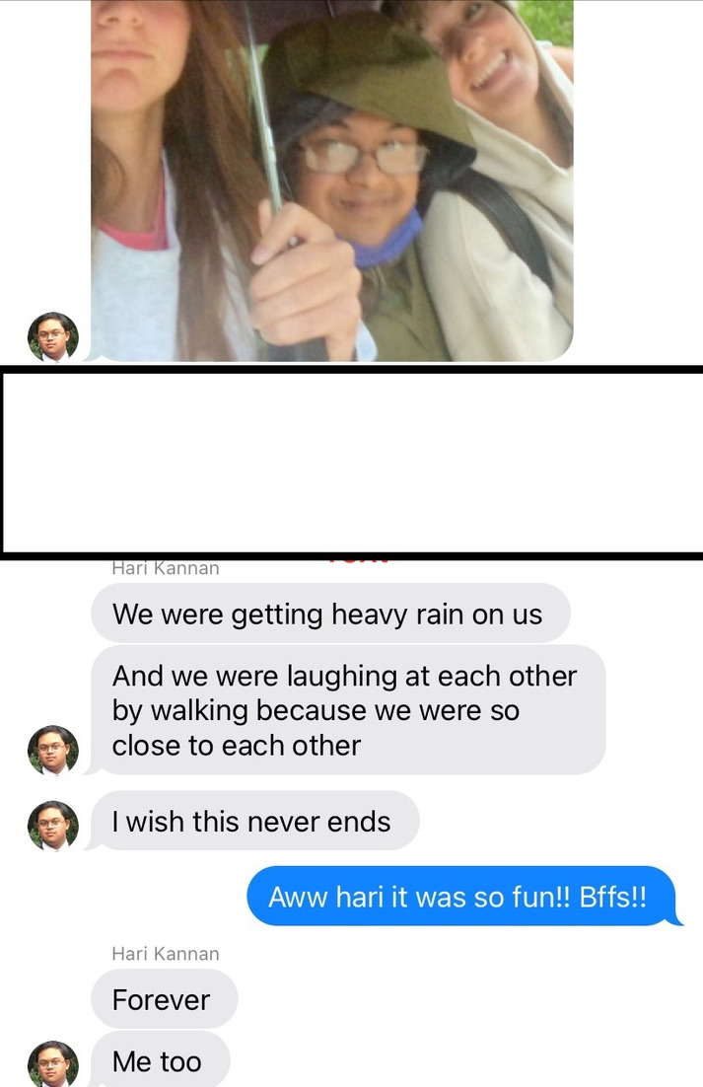
College Success: Inclusion Works!
Notes:
Meredith
Inclusive Living, Learning, Earning

Slide 17
Resources
ihehub@umd.edu
https://www.ihehub-umd.org/terps-exceed
Diamondback TerpsEXCEED
https://today.umd.edu/inclusion-matters
NBC TerpsEXCEED News Clip
Amy Dwyre D’Agati adwyre@umd.edu
Meredith Gramlich mgramlic@umd.edu
Notes:
Discussion

Slide 18
Student Highlights
& Questions?
Notes:
Student highlights

